Slide 1
Comparison of Well Completion Techniques for Gas and Hydrogen Storage
Emmanuel Ime Etim, Ifeanyi Francis Izuegbunam, and Kazi Ashraful Alam

Slide 2
Outline
Why this matters
Scope and Objectives
UGS Options Overview
Gas Vs Hydrogen: Key Differences
Well Completion Goals
Storage Completions: Natural gas Vs Hydrogen
Comparative Technical and Economic Analysis
Case Studies & Innovations
Emerging Trends and Future Outlook
Conclusion and Recommendation
Q&A

Slide 3


Introduction
Natural gas is mature
Hydrogen is emerging

Slide 4
Compare completions for natural gas vs hydrogen storage
Evalaute technical and economic differences
Explore innovations and risks

Slide 5
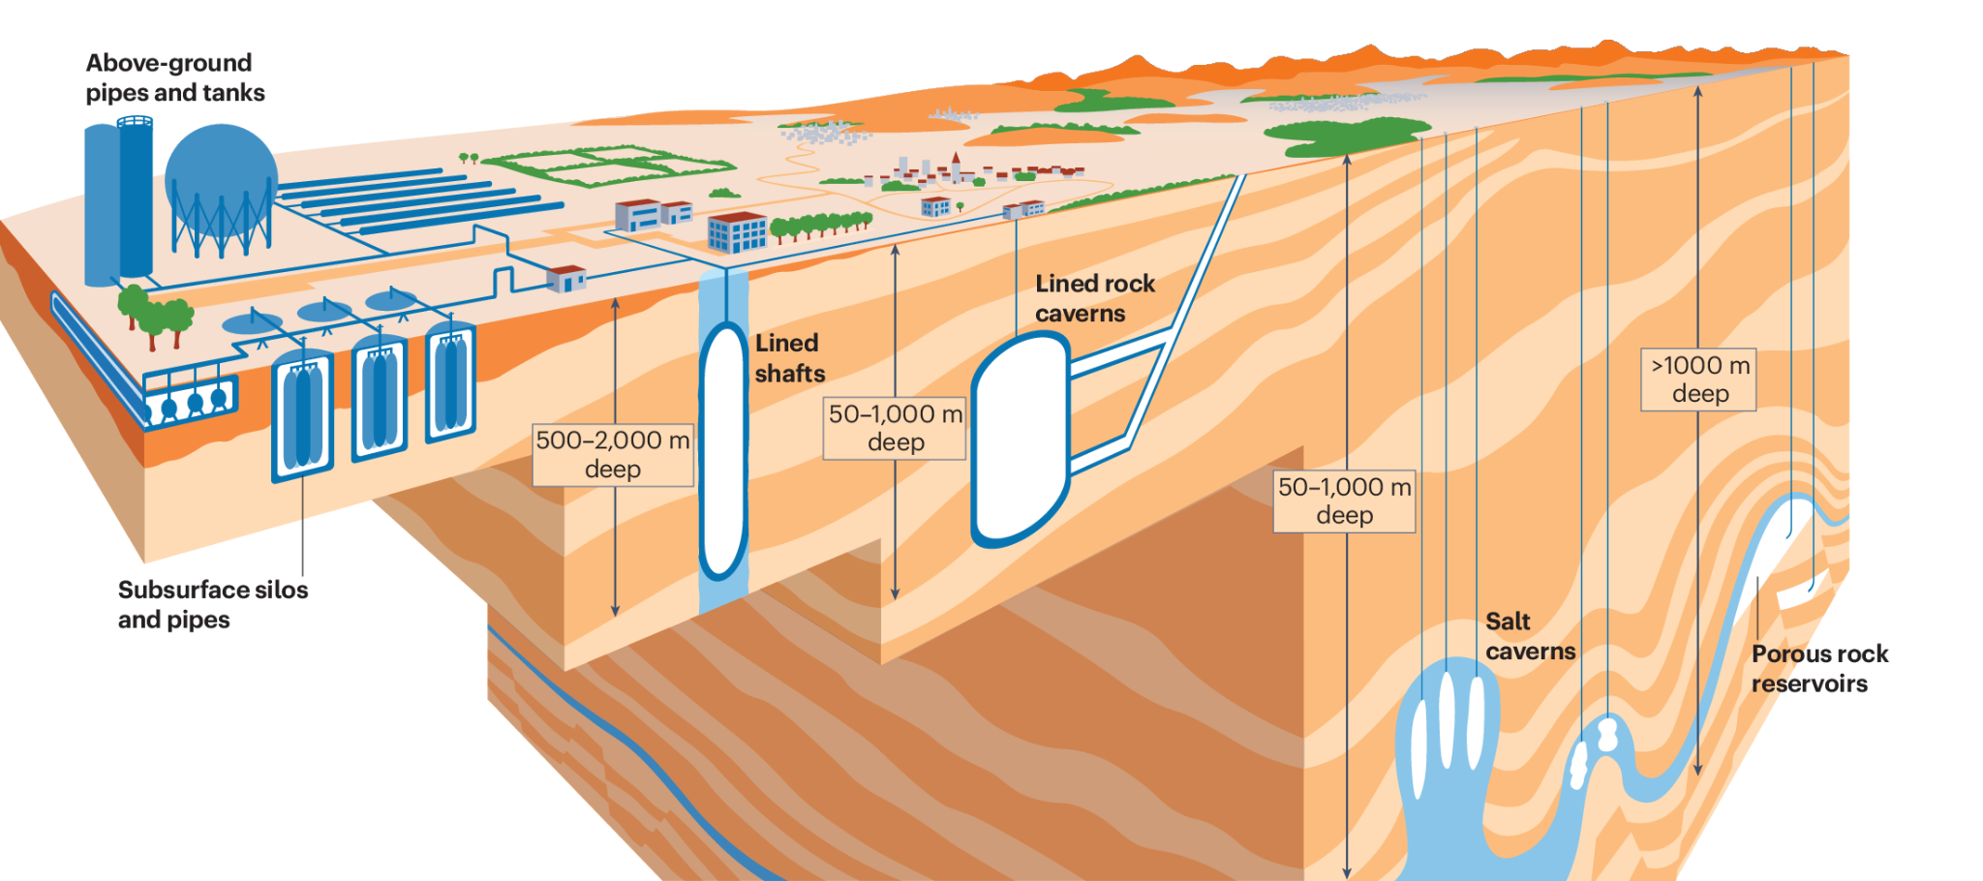
Types of Underground Storage
Salt Caverns
Depleted reservoirs
Lined rock caverns (LRCs)
Aquifers & Porous media
Using a liquid carrier

Slide 6
Gas Vs Hydrogen: Key Differences
Property | Natural Gas | Hydrogen
Diffusivity | Low | High
Reactivity | Low | High
Embrittlement Risk | None | Major
Leakage Potential | Contained | High

Slide 7
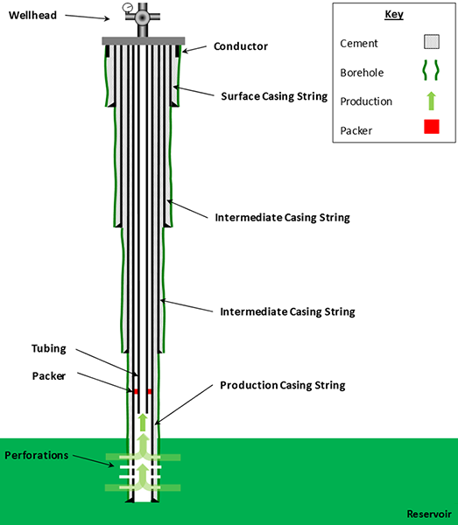
Well Completion
Is the process of preparing a well for production or injection after drilling.
Notes:
OPen Hole: DIrect contact, low cost
Cased Hole: High Isolation, widely used
Hybrid

Slide 8
Well Completion Goals
Zonal isolation
Maximize production and injection efficiency
Maintain well integrity
Optimize cost and operational efficiency
Enable effective reservoir management
Ensure environmental and safety compliance

Slide 9
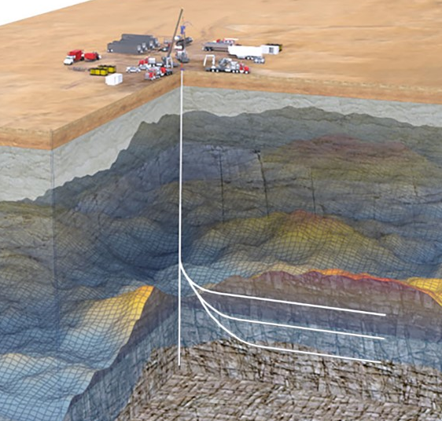
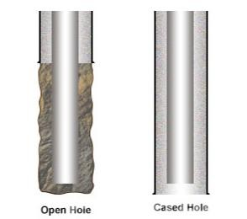
Well Completion Types
Open Hole
Cased Hole
Multilateral
Notes:
OPen Hole: DIrect contact, low cost
Cased Hole: High Isolation, widely used
Hybrid

Slide 10
Gas Storage Completions
Dual Completions:
Gas-lift systems: Injecting high pressured gas to reduce hydrostatic pressure and to boost flow
Salt cavern specific completions: High pressured, cementing to ensure zonal isolation and special packers and CR tubing to address salt creep and casing deformation.
Notes:
ToDo: Provide installation instructions!

Slide 11
Gas Storage Materials Mitigation
Corrosion Resistant alloys: Exposure to sour gas and aggressive formation waters. CRA’s such as Inconel, stainless steel and Nickel-based materials are used.
Thermal Expansion Management: temperature fluctuations should be accommodated during injection/or production. Flexible connection, expansion joints and appropriate material choices.
Notes:
ToDo: Provide installation instructions!

Slide 12
Hydrogen Storage Completions
Hydrogen Embrittlement
High Diffusivity
Potential for Microbial Activity
Notes:
ToDo: Provide installation instructions!

Slide 13
Hydrogen Storage Materials Mitigation
Polymer-Lined tubing
Coated Casing
Real-Time monitoring
Notes:
ToDo: Provide installation instructions!

Slide 14
Hierarchy Structures
Non-hierarchy level
First level
Second level
Third level
4th level
Notes:
ToDo: Provide installation instructions!

Slide 18
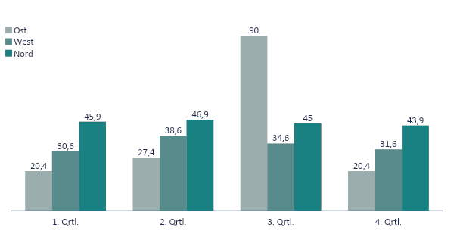
Example with Diagram

Slide 22
Widescreen Test (16:9)
Test
Aspect Ratio
(Should be displayed as a circle)
4x3
16x9

